Slide 1
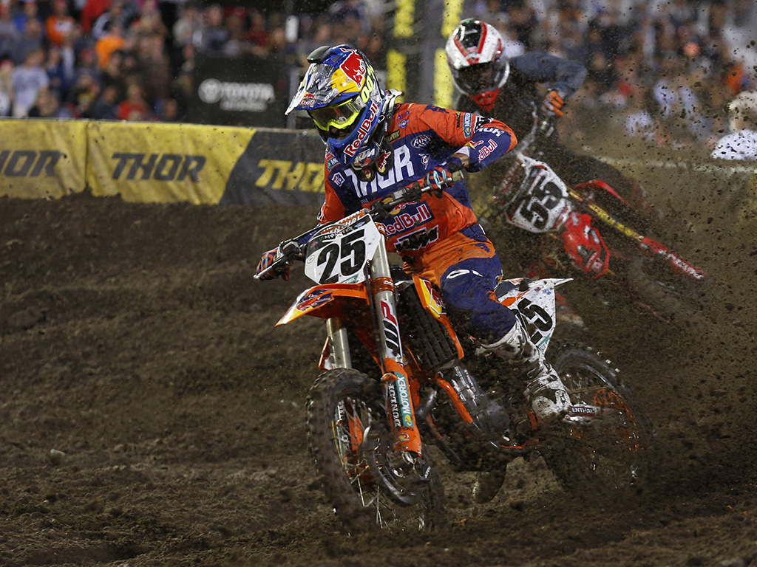
Marketing Mix Place
Place - Event location and distribution of products
  Where Ticket sales occur- direct on site, their website, online at vendors (Ticketmaster etc.) included in hotel packages
  Distribution: download, physical ticket
  Auxiliary products: people go online
  after an event to purchase related
  products, booth at events
  Bringing in props, stages etc. to make
  the place the image of the event
  ex: dirt at Daytona

Slide 2
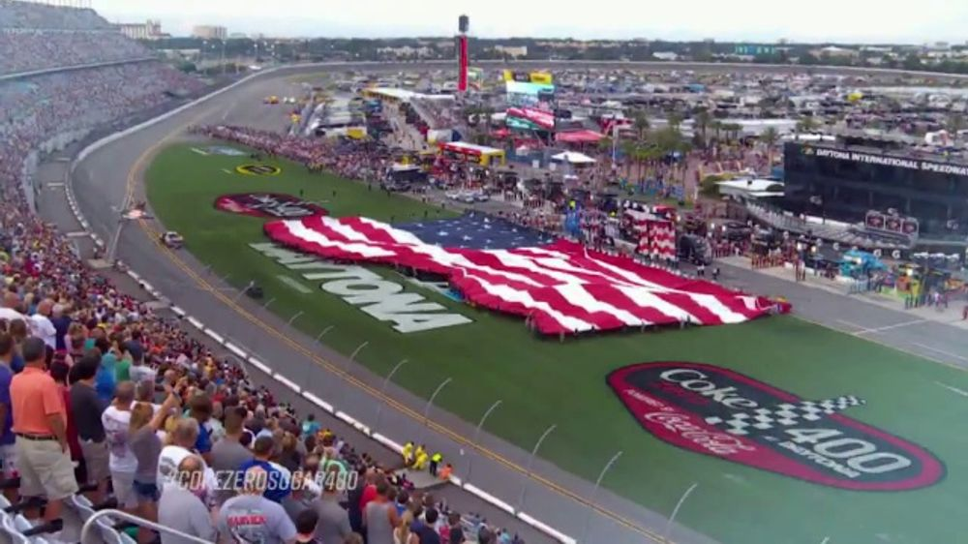
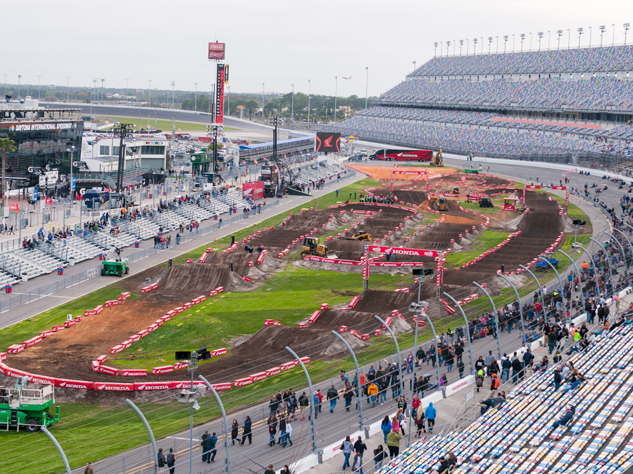
Marketing Mix Place

Slide 3
Marketing Mix Promotion
  Promotion: How you communicate your product to your customers
  Use a Promotional mix: Television, newspaper, web, and radio ads
  Digital Billboards
  Emails
  Social Media – Yours, community forums, and others
  Websites: Yours, your sponsors, and community forums
  Endorsements and or Sponsorships
  In stadium ads (coupons on back of tickets)

Slide 4
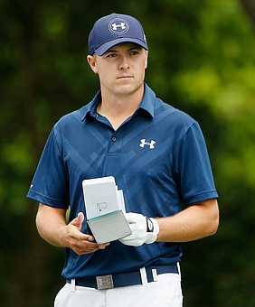
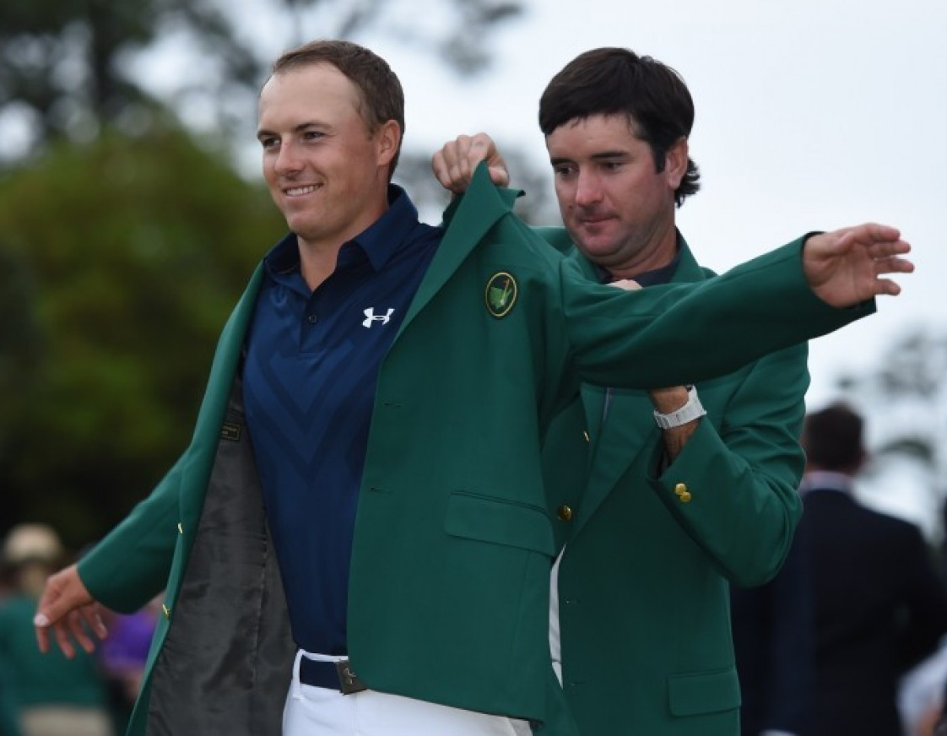
Marketing Mix Promotion
  Endorsements: a person’s public expression of approval or support for a product (goods, service, or idea).
    usually by a celebrity lending his/her image/name to a product
    Paid more in sponsorships than in
    pay checks
    Ex: Jordan Spieth
      What product does Spieth Endorse?
      How many logos was he wearing
      during the masters?
      Has a contract until 2025

Slide 5
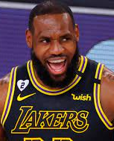
Top Deals in Endorsements
Athlete: Lebron James,
Sport: basketball (NBA – Los Angeles Lakers)
Brand: Nike
Start of endorsement: 2003 (lifetime deal)
Commonly considered one of the greatest athletes to ever grace the NBA and professional sport with his presence. A No. 1 overall draft pick straight out of high school cemented Lebron as the biggest endorsement opportunity since Tiger Woods. Before Lebron even stepped on an NBA court, he had become a millionaire through endorsement offers. At the age of 18, Lebron turned down a $10 million check from Reebok to not meet with Nike and Adidas. The footwear behemoth, Nike soon swooped in on Lebron and in 2015 he resigned for an unheard of
  $1 Billion (minimum) lifetime deal
  one of the largest (if not the largest) Nike endorsement deals in history. Is there any better contract than a Nike lifetime contract?

Slide 6
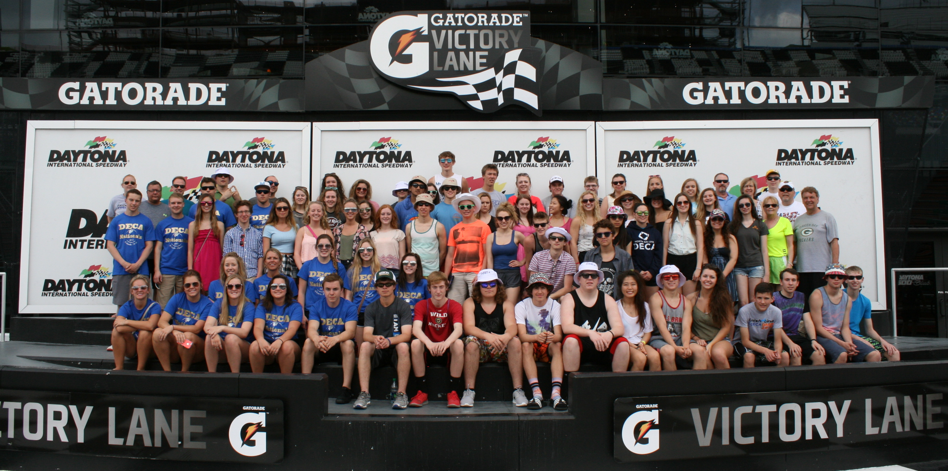
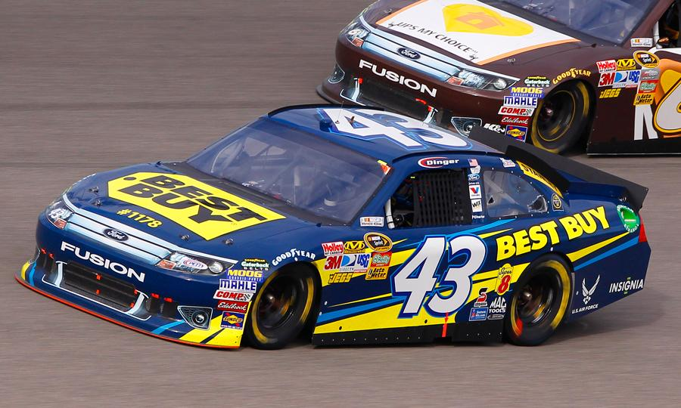
Marketing Mix Promotion
  Sponsorships – an organization, or business that gives money or donates products and/or services to another organization or event in exchange for public recognition

Slide 7
Sponsorships
Sponsorship is much more than an outfield sign at a baseball park or a logo on a racecar.
Sponsorship provides, business access, connections, hospitality, audience access, data, and helps to shape public perception
Sponsors gain brand awareness and increased brand preference
Exclusive rights to the event – competitors not allowed
Sponsors may use the images and logo of the partner and call themselves an official sponsor of the property.
Millions are spent on sponsorships

Slide 8
Complete Group Assignment Part B

